Slide 1

David M. Kroenke and David J. Auer Database Processing Fundamentals, Design, and Implementation
Appendix H:
The Semantic Object Model

Slide 2
Chapter Objectives
To define the term semantic object
To define and illustrate the use of simple, group, and object link attributes
To demonstrate the use of semantic object diagrams to build a data model
To define and illustrate the seven basic types of semantic objects
Compare the semantic object model to the entity-relationship model

Slide 3
Introduction
The semantic object model is a data modeling tool.
It was introduced in 1988.
The E-R model and the semantic object model may both be used for data modeling.
They are alternate tools for data modeling.
However, they may not produce exactly the same data models.

Slide 4
Different Data Models for Database Designs
The goal of database design is to determine entities or objects, attributes, and relationships.
The equivalent of entities of the E-R model are the semantic objects of the Semantic Object Model.

Slide 5
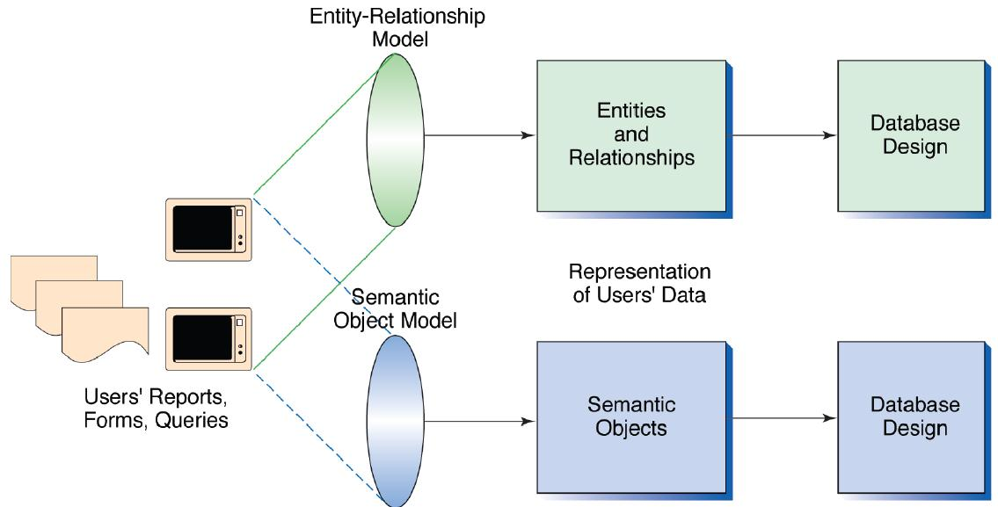
Different Data Models for Database Designs

Slide 6
Semantic Objects
A semantic object is a named collection of attributes that sufficiently describes a distinct identity.
Semantic objects are grouped into classes with names that distinguish one class from other classes.
A particular semantic object is an instance of the class.
An object has a collection of attributes.
Each attribute represents a characteristic of the identity being represented.
Objects represent distinct identities, i.e., they are recognized as independent and separate things that users want to track and report.

Slide 7
Attributes
Attributes define characteristics of semantic objects.
Three types of attributes:
Simple attributes have a single element.
Group attributes are composites of other attributes.
Object attributes or object links are attributes that establish a relationship between one semantic object and another.
Paired attributes: if an object contains another object, the second object will contain the first.

Slide 8
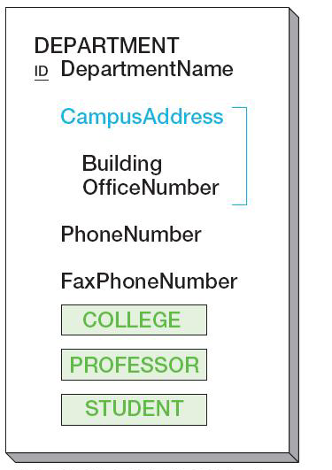
Object Diagram
Object diagrams are used to summarize the structures of objects and to present them visually.
DEPARTMENT object diagram

Slide 9
Attribute Cardinality
Each attribute has both a minimum and a maximum cardinality.
Minimum cardinality indicates the number of instances of the attribute that must exist for the object to be valid:
If it is 0, the attribute is not required to have a value.
If it is 1, it must have a value.
Minimum cardinality can sometimes be larger than 1.
Maximum cardinality indicates the maximum number of instances of the attribute that the object may have:
If it is 1, the attribute can have no more than one instance.
If it is N, the attribute can have many values, and the absolute number is not specified.
Maximum cardinality can be a specific number.

Slide 10
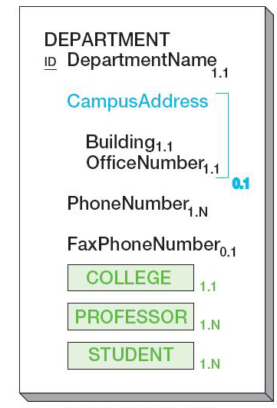
Object Diagram with Cardinalities
Object diagrams can show minimum and maximum cardinalities.
DEPARTMENT object diagram with cardinalities

Slide 11
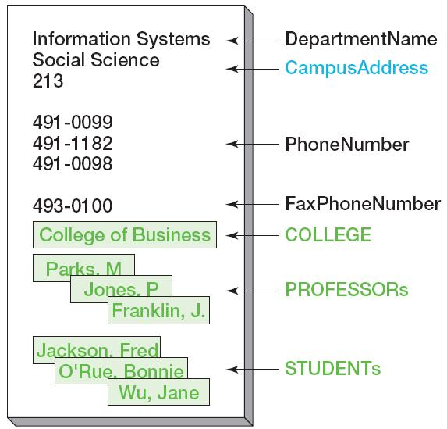
Object Instances
Object instances show actual values of the object attributes.
An instance of the DEPARTMENT object

Slide 12
Object Identifiers
An object identifier is one or more object attributes that the users employ to identify object instances.
Identifiers, denoted by “ID” in front of the attribute, are potential names for a semantic object.
A group identifier is an identifier that has more than one attribute:
{FirstName, LastName}
Object identifiers may or may not be unique.
If an attribute is to be used as an identifier, its value is required.
Normally, cardinality of an ID attribute is 1.1.

Slide 13
Attribute Domains
An attribute domain is a description of an attribute’s possible values.
A simple attribute domain consists of:
A physical description: indicates the type and length of data and other constraints
It can be an enumerated list, i.e., the set of an attribute’s specific values: {‘Blue’, ‘Yellow’, ‘Red’}.
A semantic description: indicates the function or purpose of the attribute

Slide 14
Attribute Domains
A group attribute domain consists of:
A physical description: a list and order of all of the attributes in the group
A semantic description: the function or purpose of the group
An object attribute domain is the set of object instances of that type.
It is a dynamically enumerated list, i.e., the list contains all of the object instances of a particular type.

Slide 15
Semantic Object Views
A semantic object view, or view, is a portion of an object that is visible to a particular application.
A view consists of the name of the object plus a list of all of the attributes visible from that view.
Views can be used:
To develop the data model.
To support new forms, reports, and queries based on the existing database structure.

Slide 16
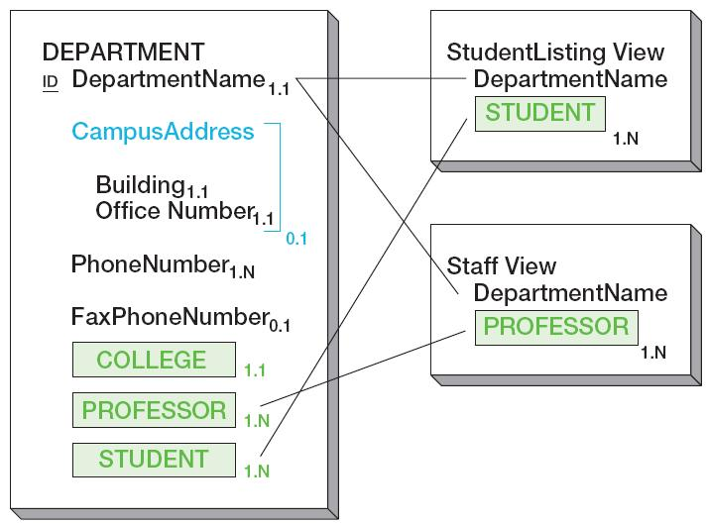
Semantic Object Views
StudentListing View of the DEPARTMENT object
Staff View of the DEPARTMENT object

Slide 17
Types of Objects
A single-value attribute is an attribute whose maximum cardinality is 1.
A multivalue attribute is one whose maximum cardinality is greater than 1.
A nonobject attribute is a simple or group attribute.
There are seven types of objects:
Simple object
Composite object
Compound object
Hybrid object
Association object
Parent/subtype object
Archetype/version object

Slide 18
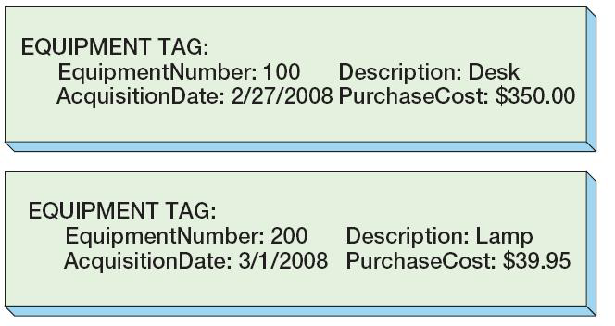
Simple Objects
A simple object contains only single-value, simple, or group attributes.
Example reports

Slide 19
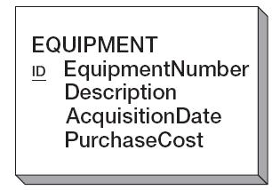
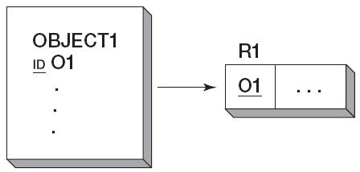
Simple Objects
EQUIPMENT simple object
General transformation of a simple object into a relation
Relation representing EQUIPMENT

Slide 20
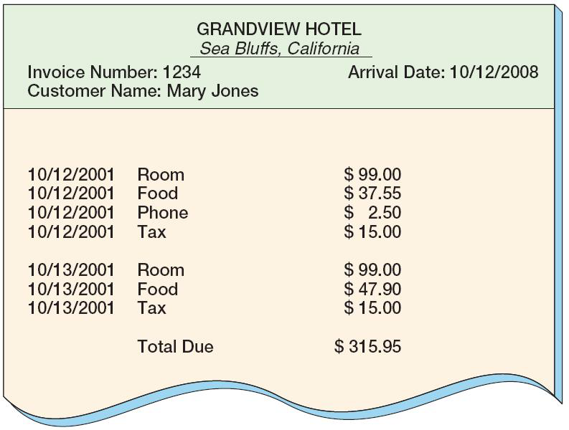
Composite Objects
A composite object is a semantic object that contains one or more multivalue, simple, or group attributes but no object attributes.
Example report

Slide 21
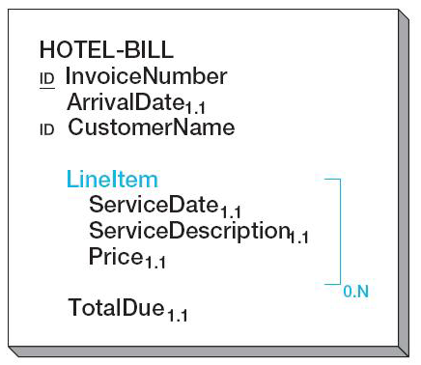
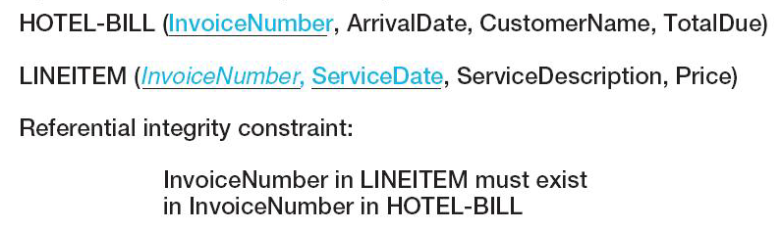
Composite Objects: Object and Corresponding Relations
HOTEL-BILL composite object
Relations representing HOTEL-BILL

Slide 22
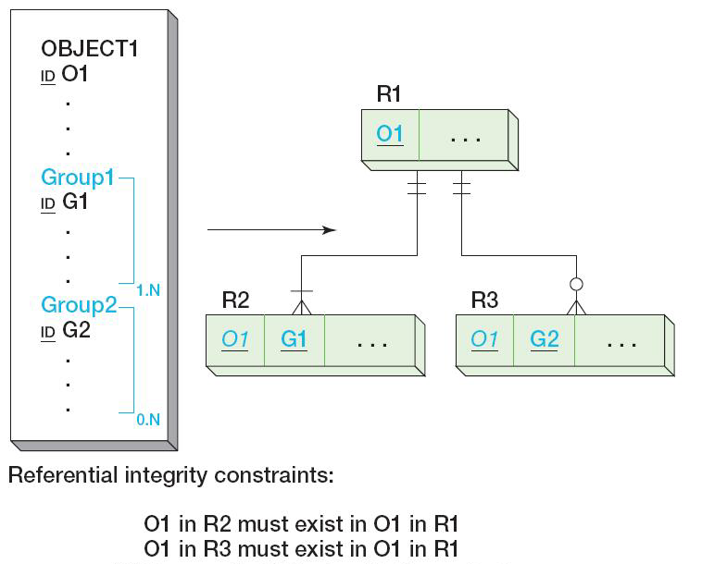
Composite Objects: General Transformation to Relations
For a composite object with separate groups:

Slide 23
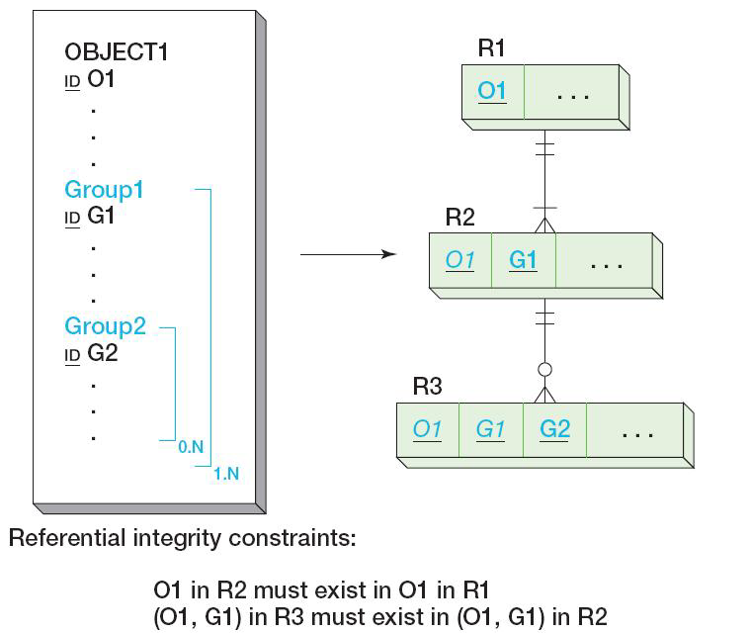
Composite Objects: General Transformation to Relations
For a composite object with nested groups:

Slide 24
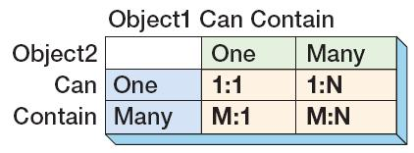
Compound Objects
A compound object contains at least one object attribute.
There are four types of compound objects:

Slide 25
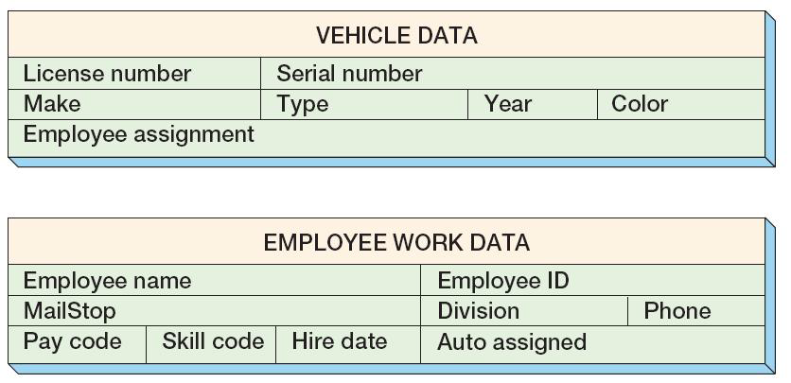
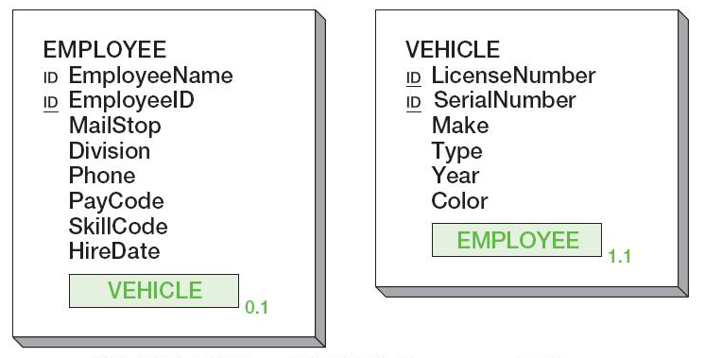
Compound Objects: Compound Objects with 1:1 Paired Properties
Example forms
EMPLOYEE and VEHICLE compound objects

Slide 26
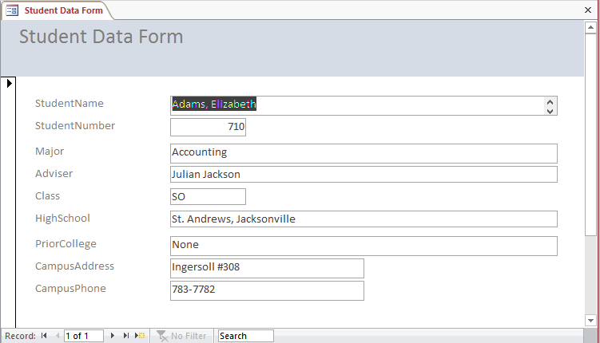
Compound Objects: Compound Objects with 1:N Paired Properties
Example report and form

Slide 27
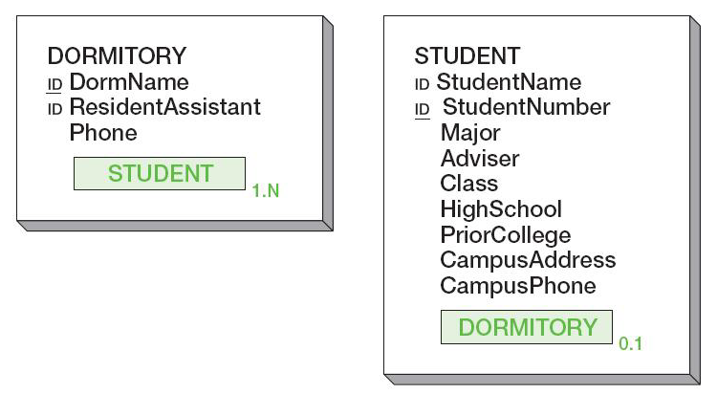
Compound Objects: Compound Objects with 1:N Paired Properties
DORMITORY and STUDENT compound objects

Slide 28
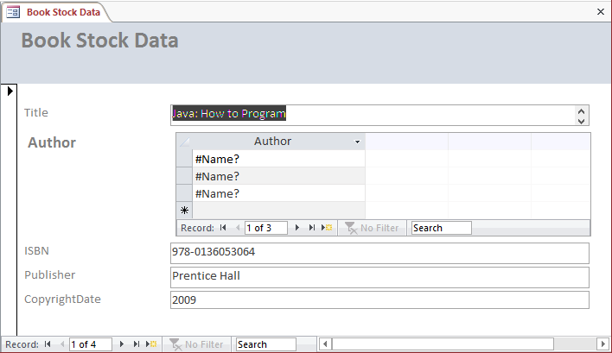
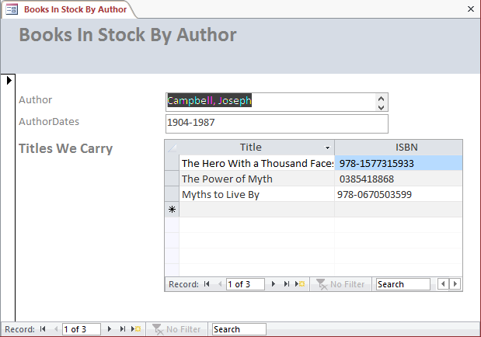
Compound Objects: Compound Objects with N:M Paired Properties
Example forms

Slide 29
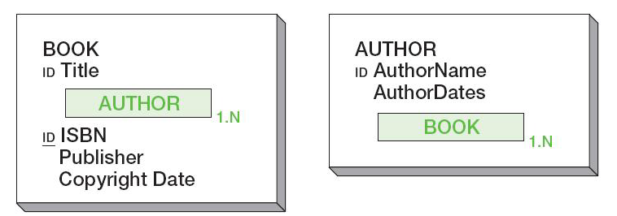
Compound Objects: Compound Objects with N:M Paired Properties
BOOK and AUTHOR compound objects

Slide 30
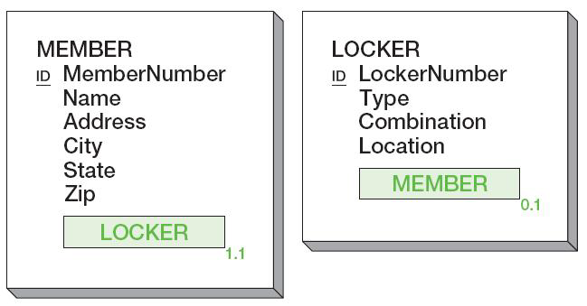
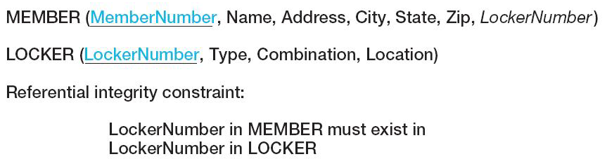
Representing Compound Objects: One-to-One [1:1] Compound Objects
MEMBER and LOCKER compound objects
Relations representing MEMBER and LOCKER

Slide 31
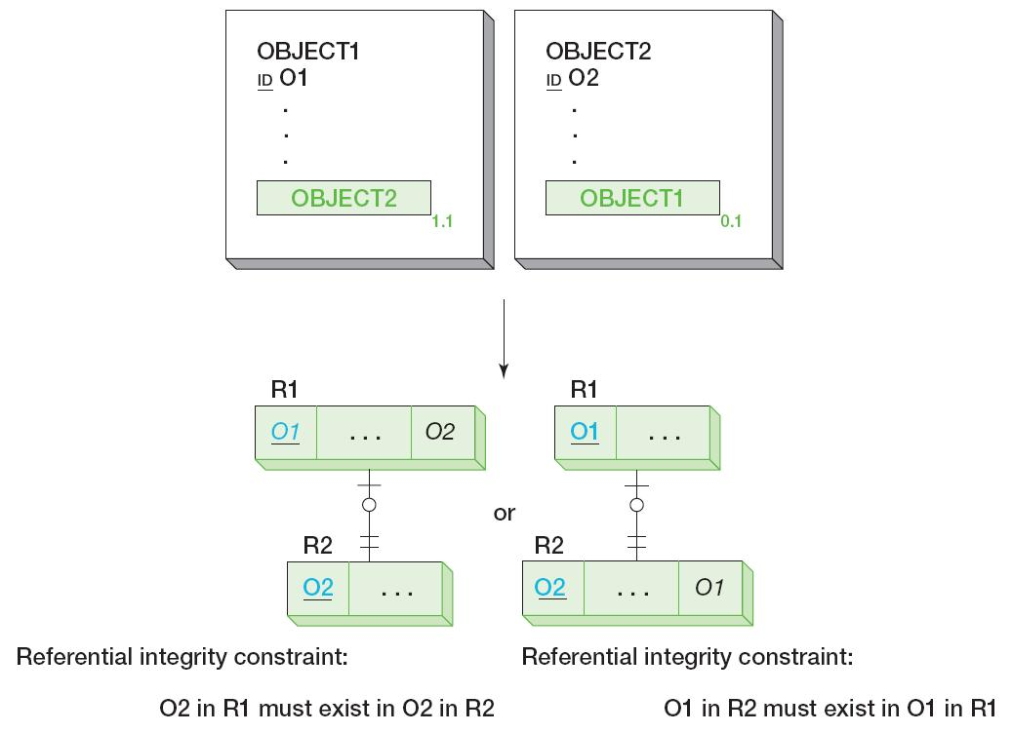
Representing Compound Objects: General Transformation of 1:1 Compound Objects

Slide 32
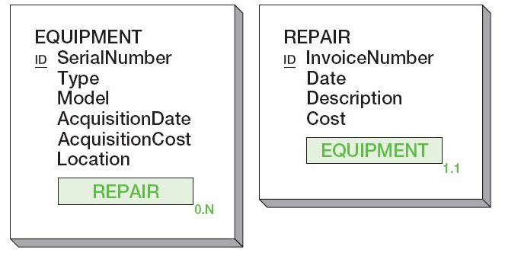
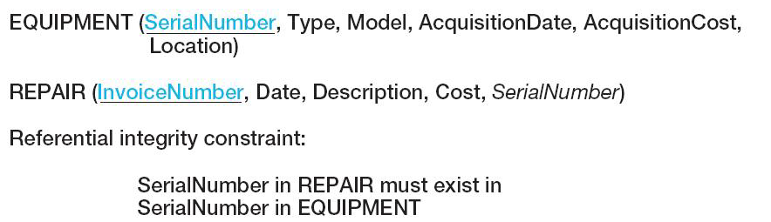
Representing Compound Objects: One-to-Many [1:N] Compound Objects
EQUIPMENT and REPAIR compound objects
Relations representing EQUIPMENT and REPAIR

Slide 33
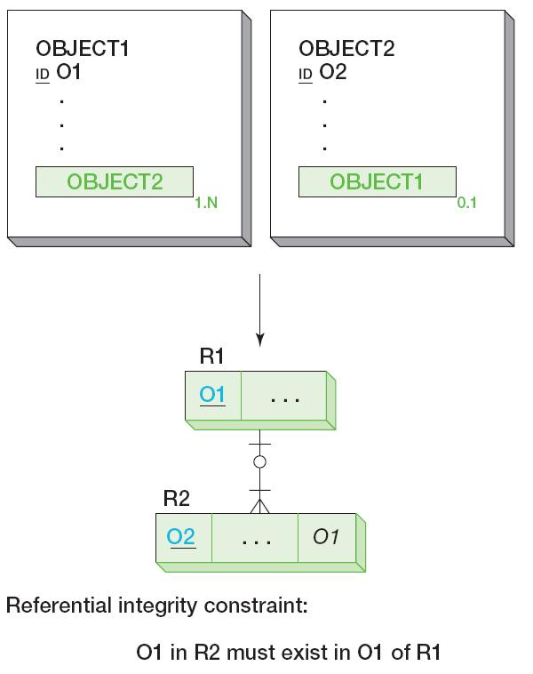
Representing Compound Objects: General Transformation of 1:N Compound Objects

Slide 34
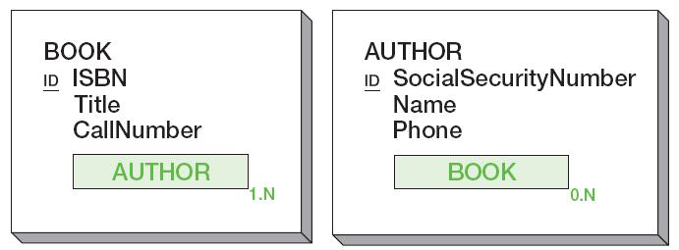
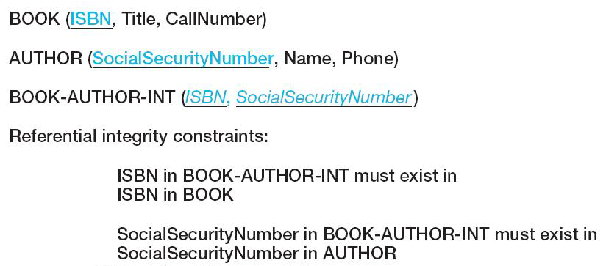
Representing Compound Objects: Many-to-Many [N:M] Compound Objects
BOOK and AUTHOR compound objects
Relations representing BOOK and AUTHOR

Slide 35
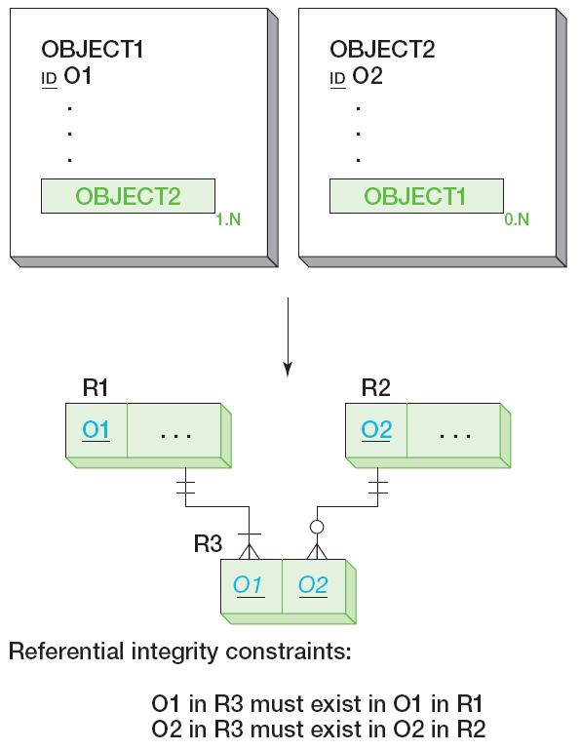
Representing Compound Objects: General Transformation of N:M Compound Objects

Slide 36
Hybrid Objects
A hybrid object is a semantic object with at least one multivalue group attribute that includes a semantic object attribute.
It is a combination of composite and compound objects.

Slide 37
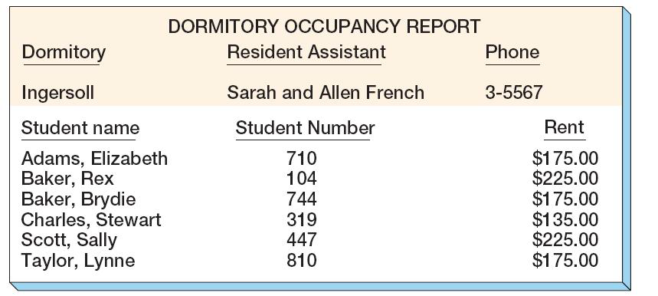
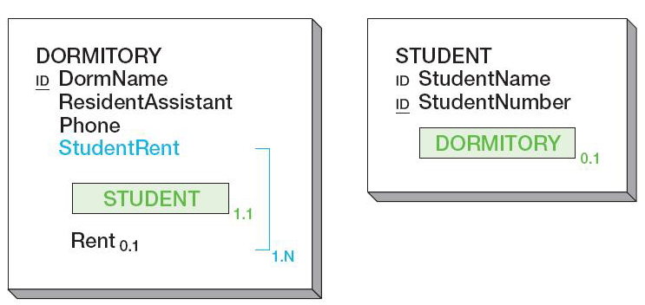
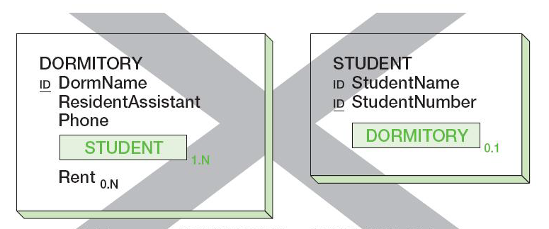
Hybrid Objects
Example report
Correct DORMITORY and STUDENT objects
Incorrect DORMITORY and STUDENT objects

Slide 38
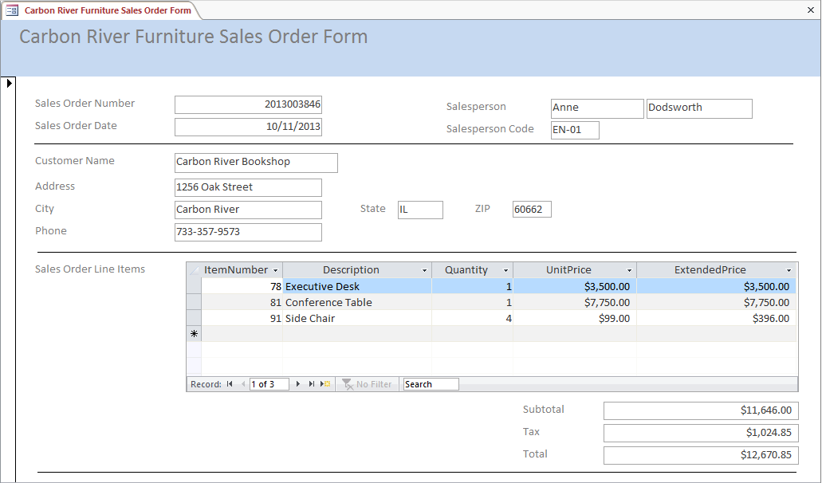
Hybrid Objects
Example Sales Order form

Slide 39
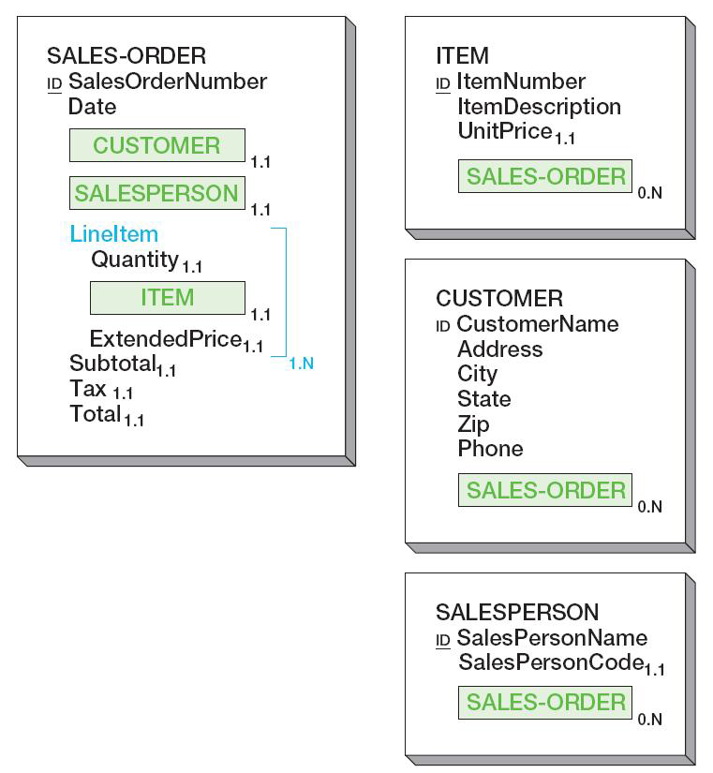
Hybrid Objects
SALES-ORDER, ITEM, CUSTOMER, and SALESPERSON objects

Slide 40
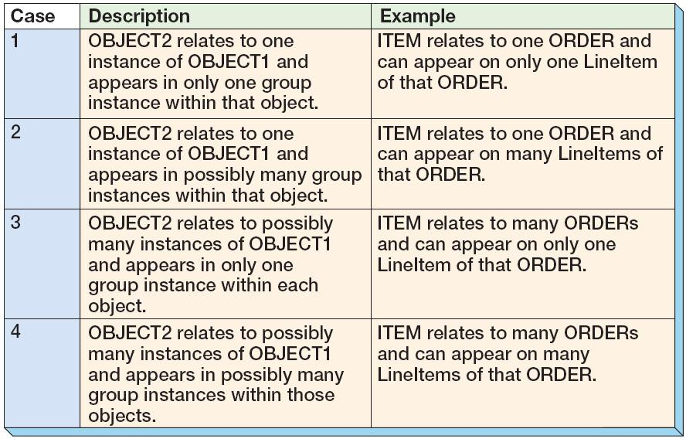
Hybrid Objects Cardinality
There are four cases of hybrid object cardinality:

Slide 41
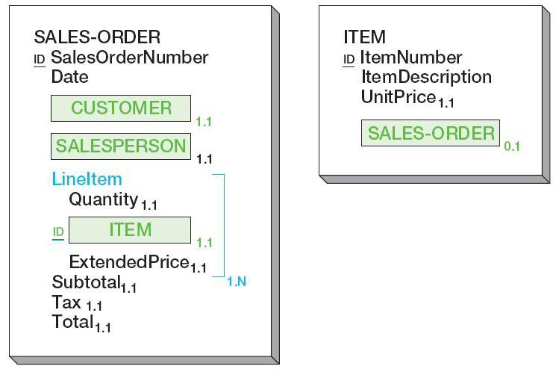
Hybrid Objects Cardinality: Example: ITEM in One Order

Slide 42
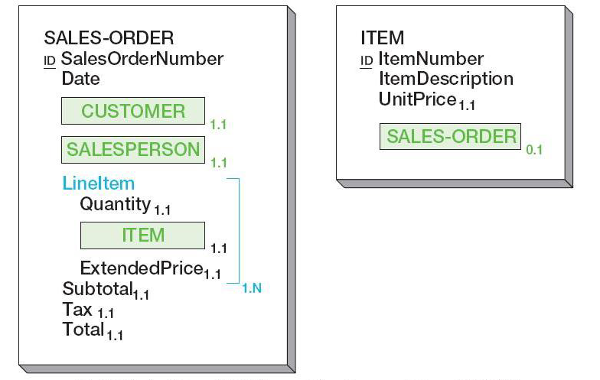
Hybrid Objects Cardinality: Example: ITEM in (Possibly) Many LineItems of One Order

Slide 43
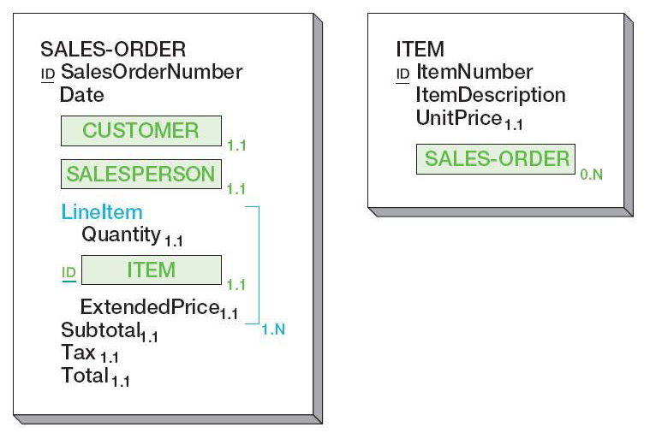
Hybrid Objects Cardinality: Example: ITEM in One LineItem of (Possibly) Many Orders

Slide 44
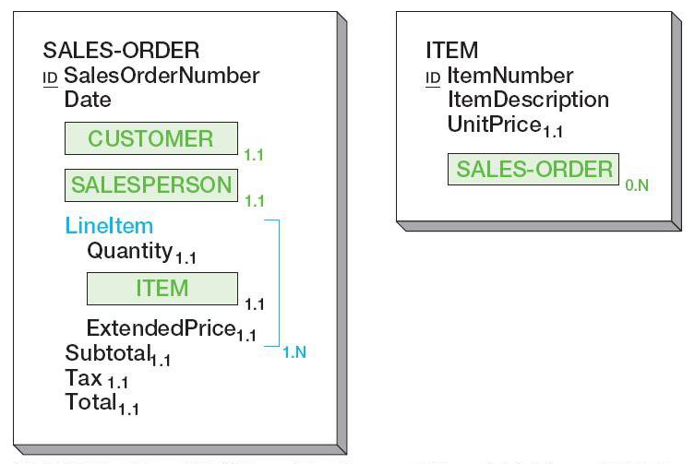
Hybrid Objects Cardinality: Example: ITEM in (Possibly) Many LineItems of (Possibly) Many Orders

Slide 45
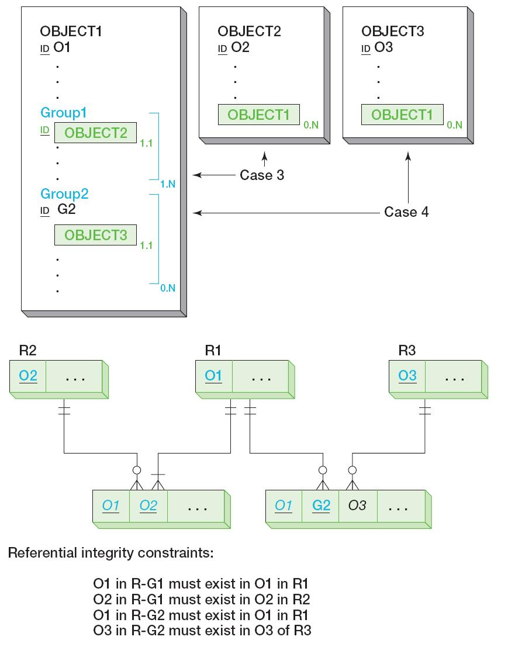
Representing Hybrid Objects: General Transformation of Hybrid Objects

Slide 46
Association Objects
An association object is an object that relates two (or more) objects and stores data that are peculiar to that relationship.

Slide 47
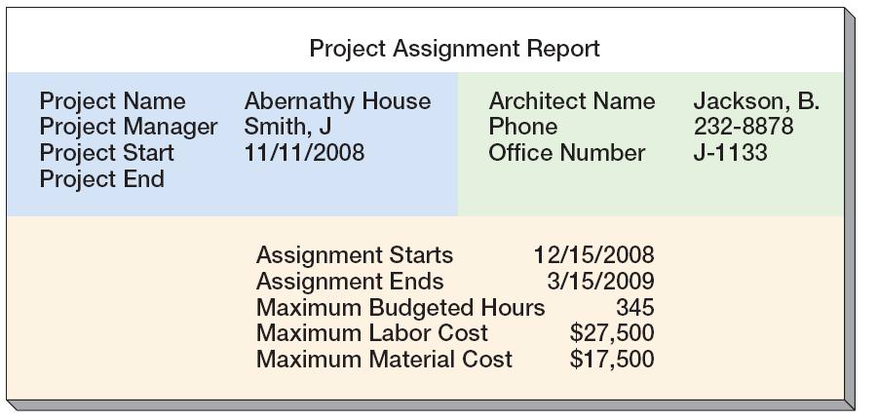
Association Objects
Example report

Slide 48
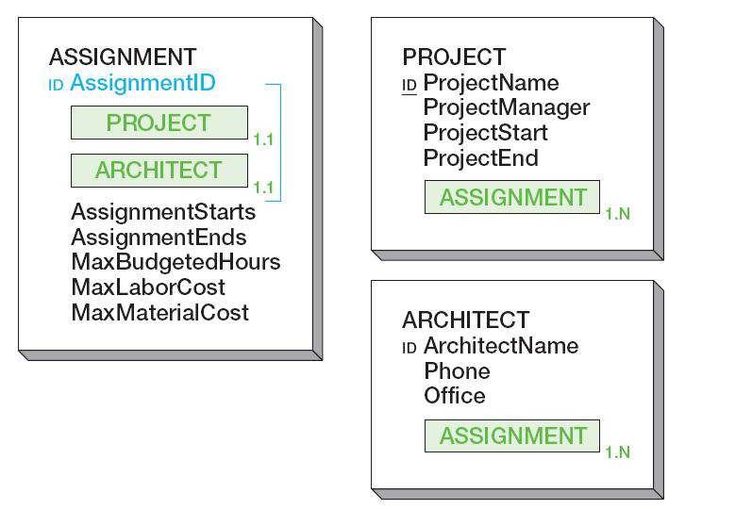
Association Objects
ASSIGNMENT, PROJECT, and ARCHITECT objects

Slide 49
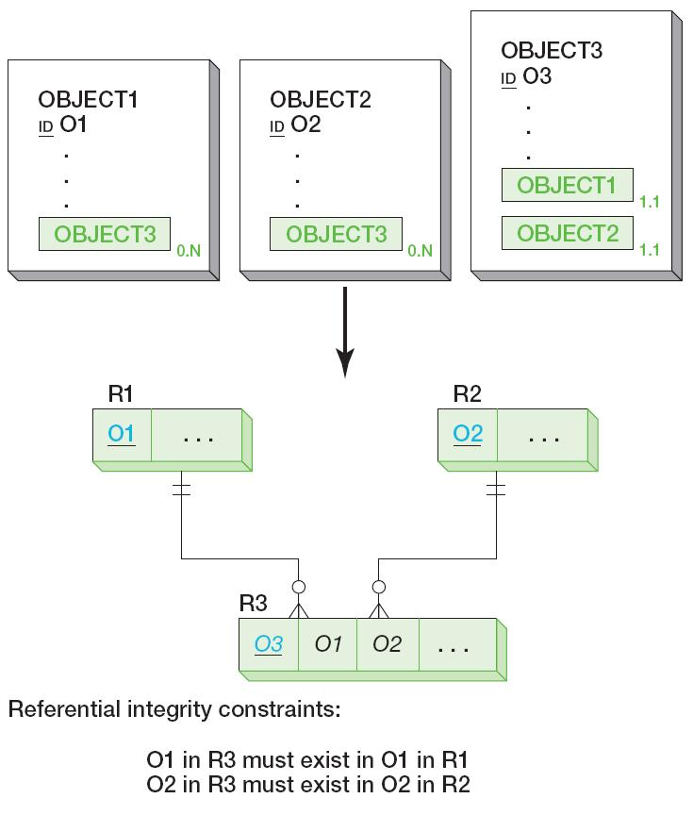
Representing Association Objects: General Transformation of Association Objects

Slide 50
Parent (Supertype)/Subtype Objects
A subtype object acquires, or inherits, all of the attributes of its parent or supertype object.
The subscript P indicates the first attribute of a subtype—the parent attribute.
Identifiers of the subtype are the same as the identifiers of the parent.
Subtype attributes have subscript 0.ST or 1.ST.
0 or 1 is the minimum cardinality and ST indicates that the attribute is in a subtype object.
An object may contain more than one subtype attribute.

Slide 51
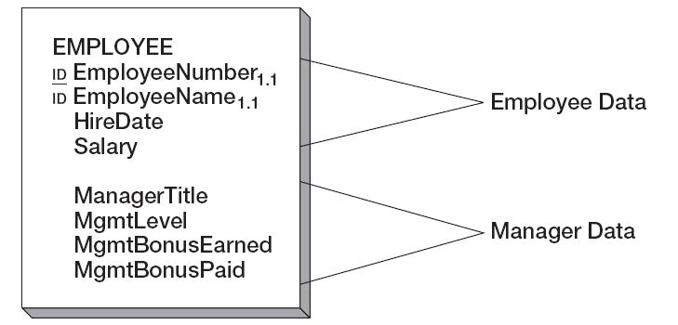
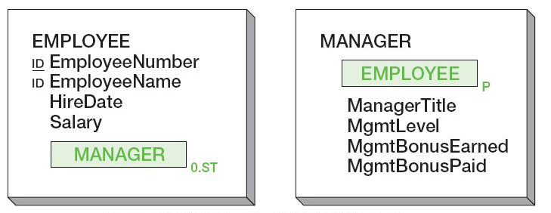
Parent/Subtype Objects
EMPLOYEE is storing both Employee and Manager data
EMPLOYEE parent (supertype) with MANAGER subtype

Slide 52
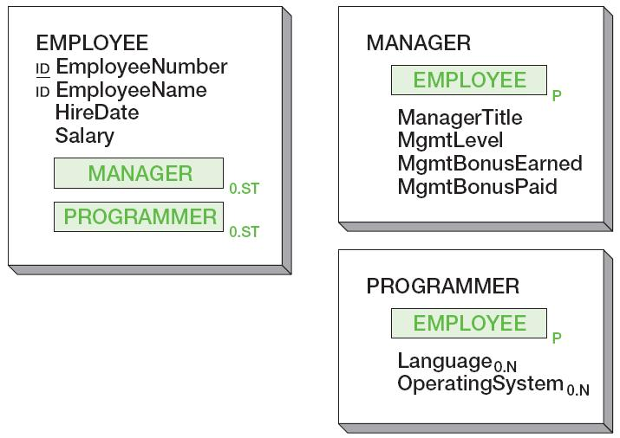
Parent/Subtype Objects: Multiple Subtypes
EMPLOYEE parent (supertype) with MANAGER and PROGRAMMER subtypes

Slide 53
Parent (Supertype)/Subtype Objects
Subtypes may be exclusive or nested:
Exclusive subtypes—the Parent may only be associated with one of the sets of subtypes
Subtype groups are used
A subscript of X.Y.Z is used:
X—minimum cardinality—0 or 1
Y and Z are counts of the number of attributes in the group that are allowed to have a value
Y—minimum required
Z—maximum allowed
Nested subtypes—subtypes within subtypes

Slide 54
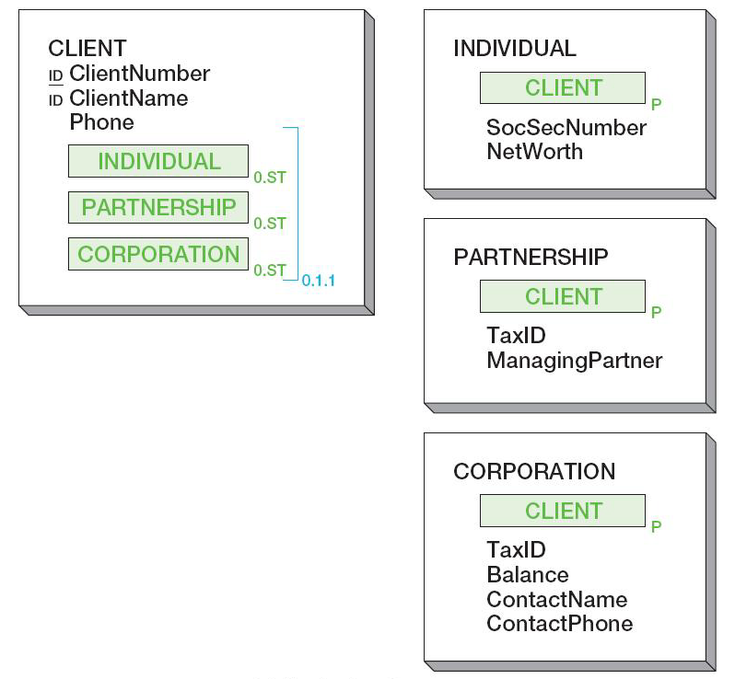
Parent (Supertype)/Subtype Objects: Exclusive Subtypes
CLIENT parent (supertype) with INDIVIDUAL, PARTNERSHIP, and CORPORATION exclusive subtypes

Slide 55
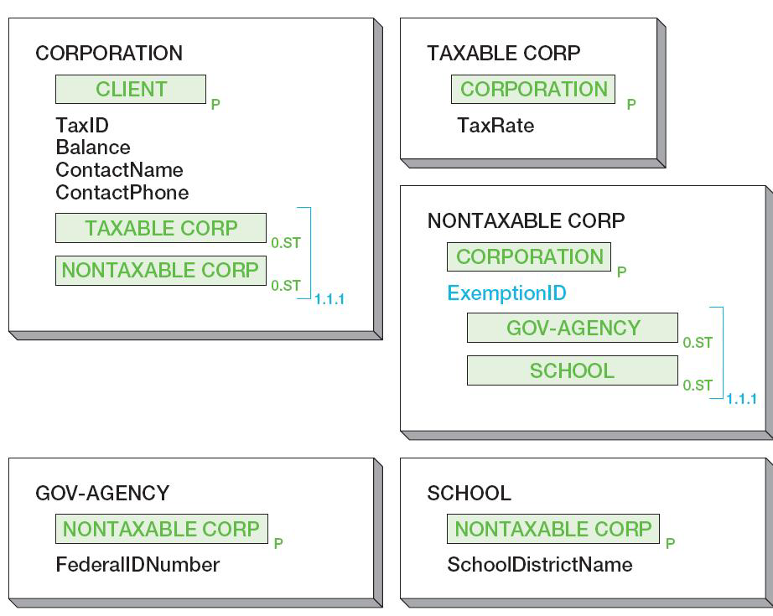
Parent (Supertype)/Subtype Objects: Nested Subtypes
CORPORATION parent (supertype) with TAXABLE CORP and NONTAXABLE CORP exclusive subtypes.
NONTAXABLE_ CORP is a parent with nested GOV-AGENCY and SCHOOL exclusive subtypes.

Slide 56
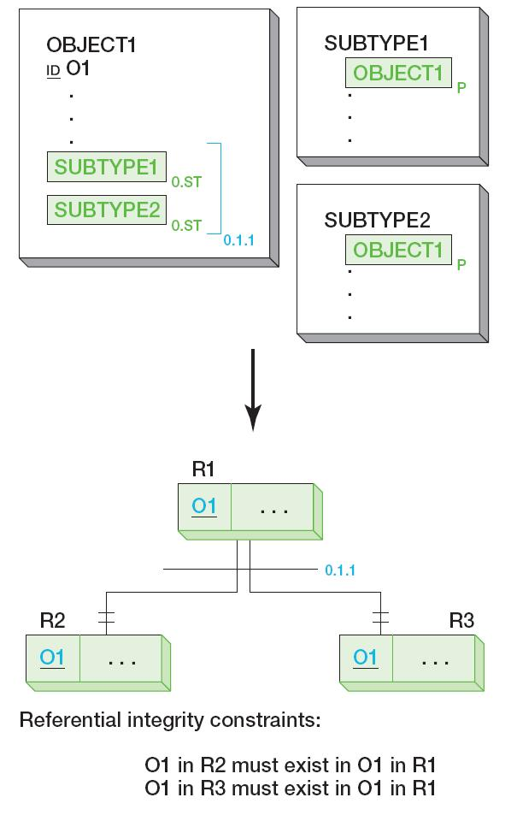
Parent (Supertype)/Subtype Objects: General Transformation of Parent/Subtype Objects

Slide 57

Archetype/Version Objects
An archetype object is a semantic object that produces other semantic objects that represent versions, releases, editions, or other instances of the archetype.
TEXTBOOK is an archetype that can manifest in the real world with versions called EDITIONs

Slide 58

Archetype/Version Objects General Transformation of Archtype/Version Objects

Slide 59
Semantic Object vs. E-R Model
Both models are tools for understanding and documenting the structure of the user’s data.
The E-R model takes the concept of atomic entity.
These atoms can be combined to form user views.
The semantic object model takes the concept of semantic object.
Set of semantic objects is a map of the user’s essential data structure.
Only semantic objects, not entities, have meaning to users.
Semantic objects are semantically self-contained, or semantically complete, which can be readily transformed into database designs.

Slide 60

Semantic Object vs. E-R Model: Entity-Relationship Sales-Order Model

Slide 61

Semantic Object vs. E-R Model: Semantic Object Sales-Order Model

Slide 62
David Kroenke and David Auer Database Processing Fundamentals, Design, and Implementation (13th Edition)
End of Presentation:
Appendix H

Slide 63

All rights reserved. No part of this publication may be reproduced, stored in a retrieval system, or transmitted, in any form or by any means, electronic, mechanical, photocopying, recording, or otherwise, without the prior written permission of the publisher. Printed in the United States of America.

